Slide 1
Configuration Management guide
W/W Development process
Sep 10, 2020
PHUONG NGUYEN
QA
Renesas Electronics Corporation

Slide 2
Agenda
Abbreviation
General definition
Overview
CM
Standard summary
Jul 2019
Aug 2020
Practical cases
CRM
Standard summary
Guideline
Trace. Manage.
Standard summary
Conclusion
Notes:
Overview: the reason why this section has too many slides

Slide 3
Abbreviation
Short form | Full word
BM | Baseline Management
CM | Configuration Management
Config. Audit | Configuration Audit
CRM | Change (Request) Management
DM | Data Management
PIC | Person In Charge
SPO | Share Point
Trace. Manage. | Traceability Management
VM | Version Management
BAR | Bug After Release
Short form | Full word
UD | Unit Design (=Detail Design in WW standard May 2018 version)
AD | Architecture Design (=Function Design in May 2018 WW standard)
WW | World Wide (standard)
VT | Validation Test (=System Test in WW standard May 2018 version)
Other abbreviations: refer Appendix 1 Glossary

Slide 4
General definition

Slide 5
General Definition baseline
Baseline:
“đường cơ sở”, by https://translate.google.com
a line that is a base for measurement or for construction, by https://en.wikipedia.org/wiki/Baseline
a line serving as a basis, by https://www.merriam-webster.com/dictionary/baseline
an imaginary line used as a starting point for making comparisons, by https://dictionary.cambridge.org/dictionary/english/baseline

Slide 6
General Definition baseline
Example: An art gallery sale received an order from a VIP client.
Client verbal discussion
I want a picture, have 2 circles with r =2m.
Requirement table
2 circles
Baseline (v1.0)
Signed requirement
A line connects 2 circle centers. Line thickness = 0.5m.
Circle and line’s color = pink.
Background color = black.
r = 2m
Circle thickness = ?
Pink color = R?G?B?
Distance between 2 circles = ?
Color of circle line = ?
…
All “?” marks have been made clear and agreed
2 same files are kept and stored by Client and Gallery

Slide 7
General Definition baseline
Example:
Output creating
Weekly report
Client change request
Add 1 equilateral triangle above the existing line, a = 2m
Baseline (v2.0)
Re-signed requirement
2 same files are kept and stored by Client and Gallery
New requirement updated
Check with Requirement and save a photograph at Gallery
Weekly deliver photograph as product status to Client
Triangle color = black
No triangle line

Slide 8
General Definition baseline
Example:
Time
v1.0
Initial Contract signed
v2.0
New CR signed
Initial plan release date
1st re-schedule plan release date after CR received
Contract/ Requirement
Paint/ Work product
v0.1
v0.2
Weekly report
1st Report
2nd Report

Slide 9
General Definition baseline
Example:
Baseline
v1.0
Initial Contract signed
v2.0
New CR signed
Initial plan release date
1st re-schedule plan release date after CR received
Contract/ Requirement
Paint/ Work product
v0.1
v0.2
Weekly report
1st Report
2nd Report

Slide 10
General Definition baseline
Example:
v1.0
Initial Contract signed
v2.0
New CR signed
Initial plan release date
1st re-schedule plan release date after CR received
Contract/ Requirement
Paint/ Work product
v0.1
v0.2
Version
Weekly report
1st Report
2nd Report

Slide 11
General Definition baseline
Example:
v1.0
Initial Contract signed
v2.0
New CR signed
Initial plan release date
1st re-schedule plan release date after CR received
Contract/ Requirement
Paint/ Work product
v0.1
v0.2
= “Data management object” in WW standard,
= “Record” in ISO9001:2015.
Weekly report
1st Report
2nd Report

Slide 12
General Definition software configuration management
Configuration Management
Data Management
Config. Audit
Customers input, minutes, progress reports, review minutes, tools, development environment, etc.
Version Management
Project Plan, Functional Design Document, Detail Design Document, Source Code, Test Specifications, Test Report, etc.
Baseline Management
(no specific work product required in Standard)

Slide 13
overview

Slide 14
overview
Why do you need CM?
Example 1: Sudden leave staff
Example 2: Bug leakage to client
Example 3: High effort for CM task in Daily work within Team
Notes:
The complexity of this question is just the same with the question “Why does your project need QA?”

Slide 15
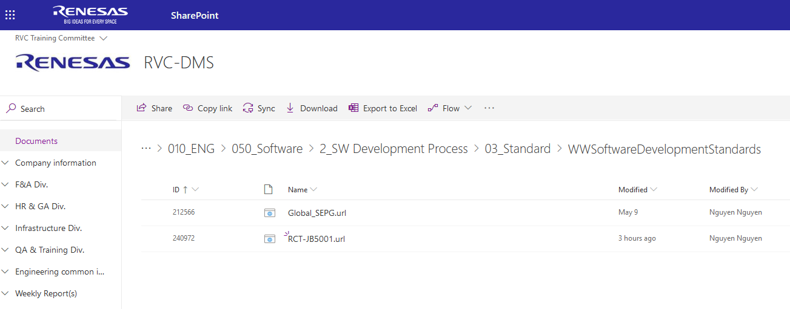
overview related standards
RVC SPO
https://renesasgroup.sharepoint.com/sites/RVC/Shared%20Documents/Forms/AllItems.aspx?sortField=ID&isAscending=true&viewid=d04fa322%2Dd11a%2D4810%2Da56e%2Dff99ccf81c9a&id=%2Fsites%2FRVC%2FShared%20Documents%2F1%2E%20General%20Documents%2F010%5FENG%2F050%5FSoftware%2F2%5FSW%20Development%20Process%2F03%5FStandard%2FWWSoftwareDevelopmentStandards

Slide 16
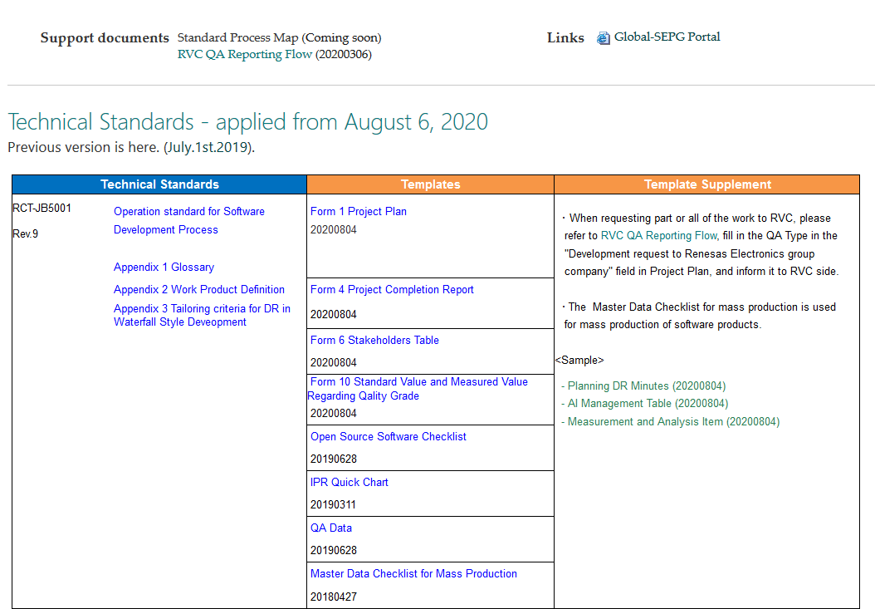
overview related standards
RVC SPO
REL QAD SPO - Aug 2020, Jul 2019, May 2018, Apr 2017 versions
https://renesasgroup.sharepoint.com/sites/REL-portal/dqiportal-en/SitePages/Software%20Development%20Standards.aspx

Slide 17
overview related standards
JB5001 Operation standard for Software Development Process
JB5001-011 Configuration Management and Change Management
JB0004 Operation Standard for Applying Standard Development Procedure Management Table
JB5001-003 Software Development: Implementation Standard for Requirement Development
RVC SPO
REL QAD SPO

Slide 18
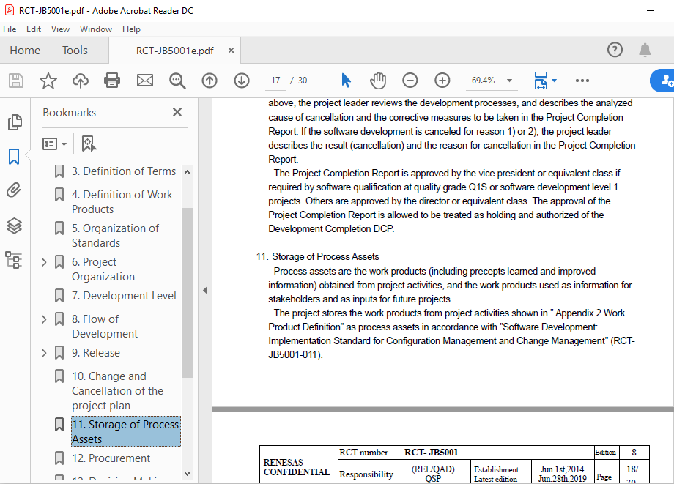
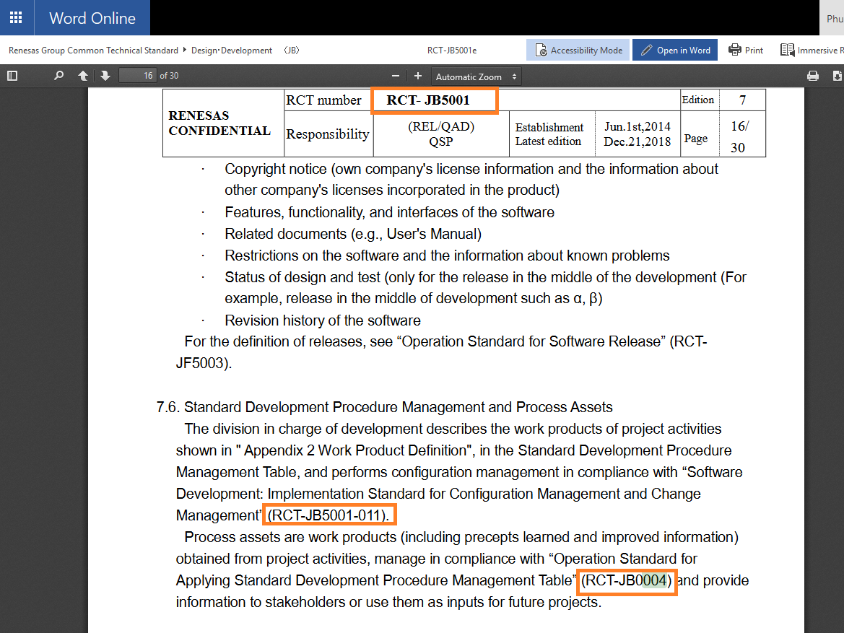
overview related standards
JB5001 – version Aug 2020, Jul 2019
JB5001 – version May 2018

Slide 19
overview related standards – highlight
CM differences between JB5001 v.May 2018, v.Jul 2019, v.Aug 2020 standards:
JB5001 v.May 2018:
JB0004 is mentioned. Its template is Standard Development Procedure Management Table (Short word SDPMT). Purpose: list out all needed Project Inputs, Outputs by process.
Table of necessary Input and Output by process is existed in JB5001.
JB5001 v.Jul 2019:
JB0004 is not mentioned.
Table of necessary Input and Output by process has been removed in JB5001.
JB5001 Appendix 2 Work Product Definition has listed the major needed work products/ activities by Waterfall, Milestone, Sprint style.
JB5001 v.Aug 2020:
1,2,3. The same with v.Jul 2019.
4. Configuration audit is removed.

Slide 20
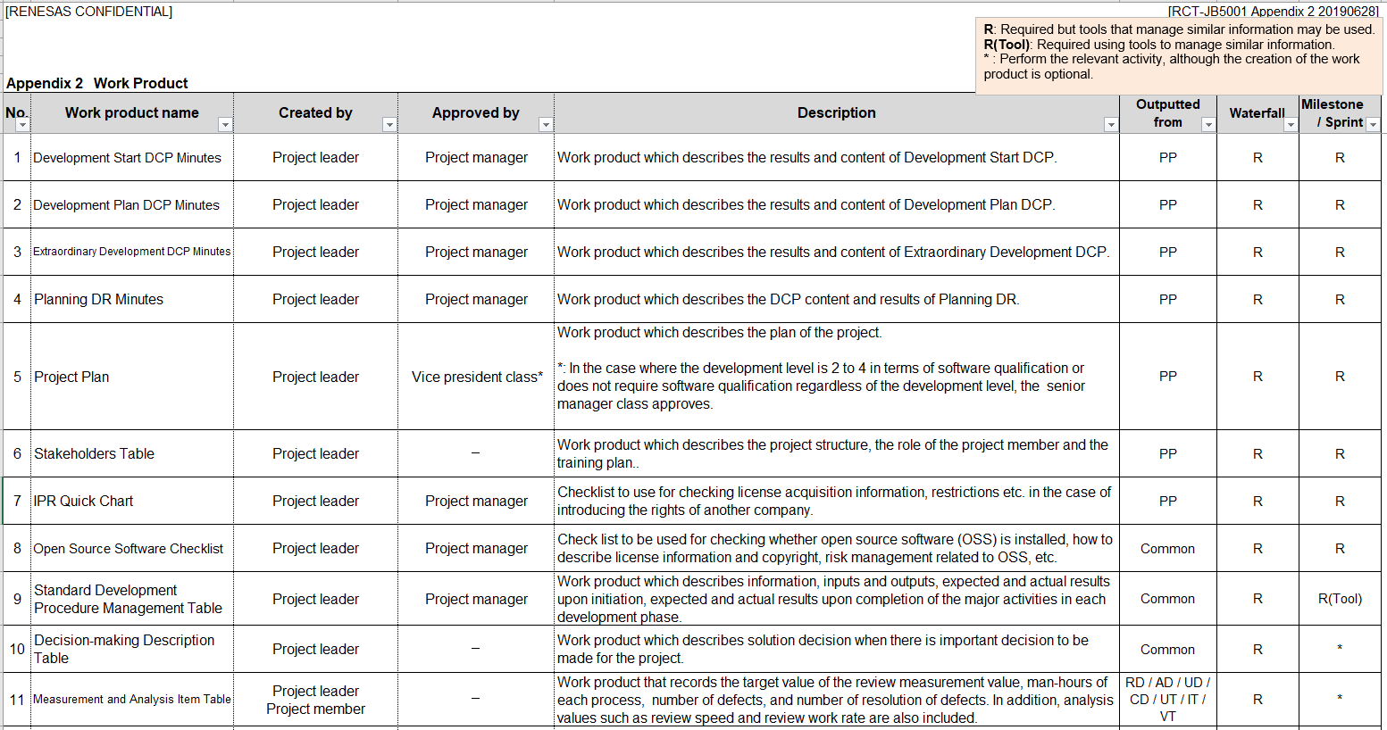
overview related standards - highlight
Not existed in JB5001 Appendix 2 Work Product Definition
Version May 2018
JB5001 Appendix 2 Work Product Definition Version Jul 2019, Aug 2020

Slide 21
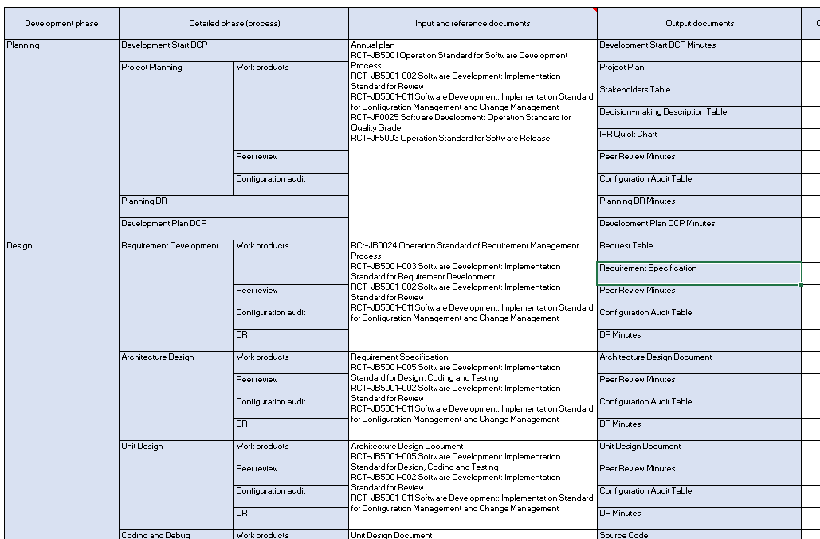
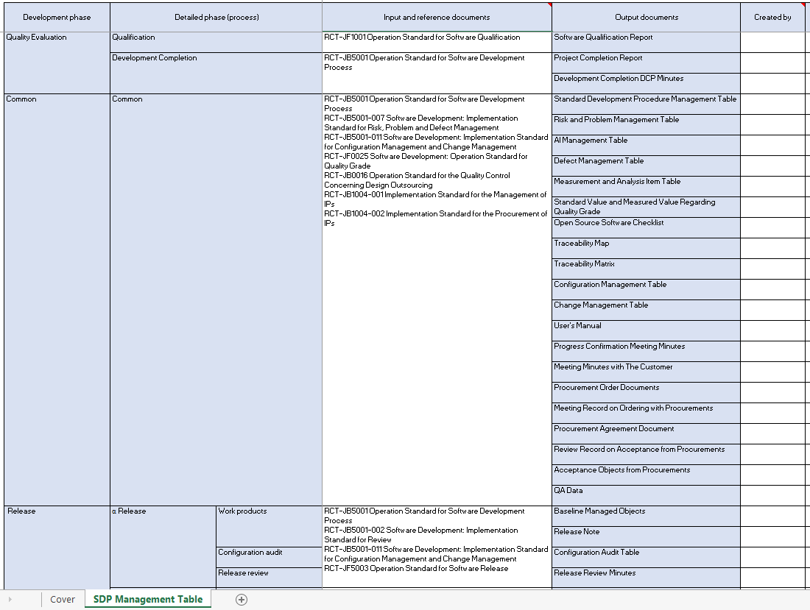
overview related standards - highlight
1
SDPMT included 5 parts:
Planning, Design, Quality evaluation, Common, Release.
This is the guideline for Project to check the needed work product at each phase.
Ex:
1. Before DR time of PP phase:
Planning + Common = Recommendation outputs and inputs
2. Before DR time of CD phase:
Design/ Coding and Debug + Common = Recommendation outputs and inputs
2
3
4
5
Notes:
Related to Risk: JB5001 Jul version has removed the table of Input, Output -> SDPMT will be more necessary than before

Slide 22
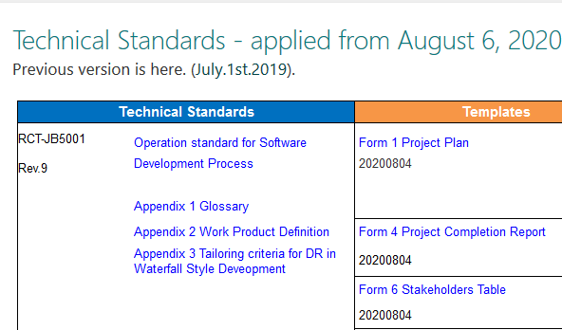
overview appendix
RVC SPO
REL QAD SPO
RCT-JB5001a2

Slide 23
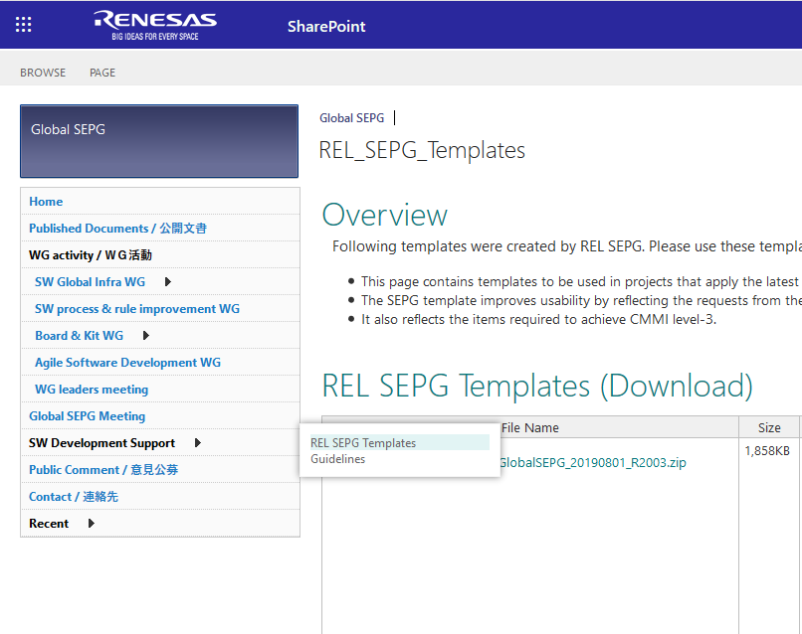
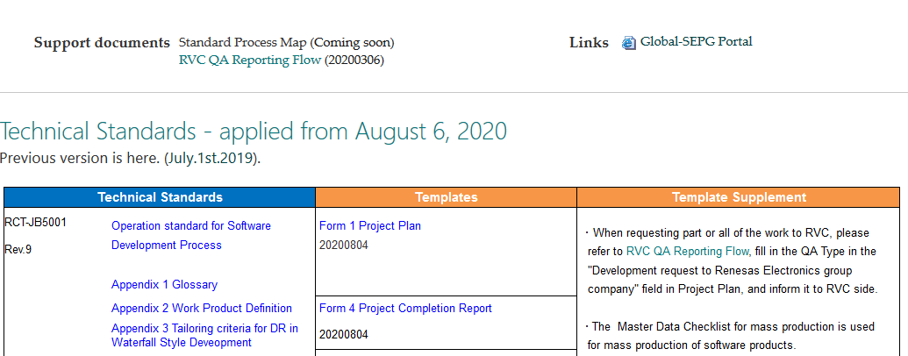
overview GUIDELINE
RVC SPO
REL QAD SPO
Global SEPG SPO

Slide 24
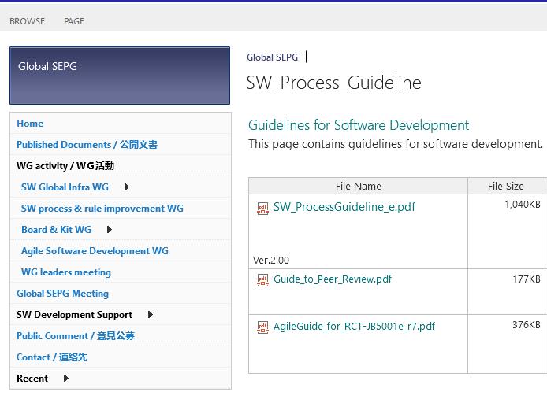
overview GUIDELINE
RVC SPO
SW_ProcessGuideline_v200e
REL QAD SPO
Global SEPG SPO

Slide 25
overview Templates
RVC SPO
REL QAD templates
REL QAD SPO
https://renesasgroup.sharepoint.com/sites/REL-portal/dqiportal-en/SitePages/Software%20Development%20Standards.aspx

Slide 26
overview Templates
RVC SPO
REL QAD SPO
Global SEPG SPO

Slide 27
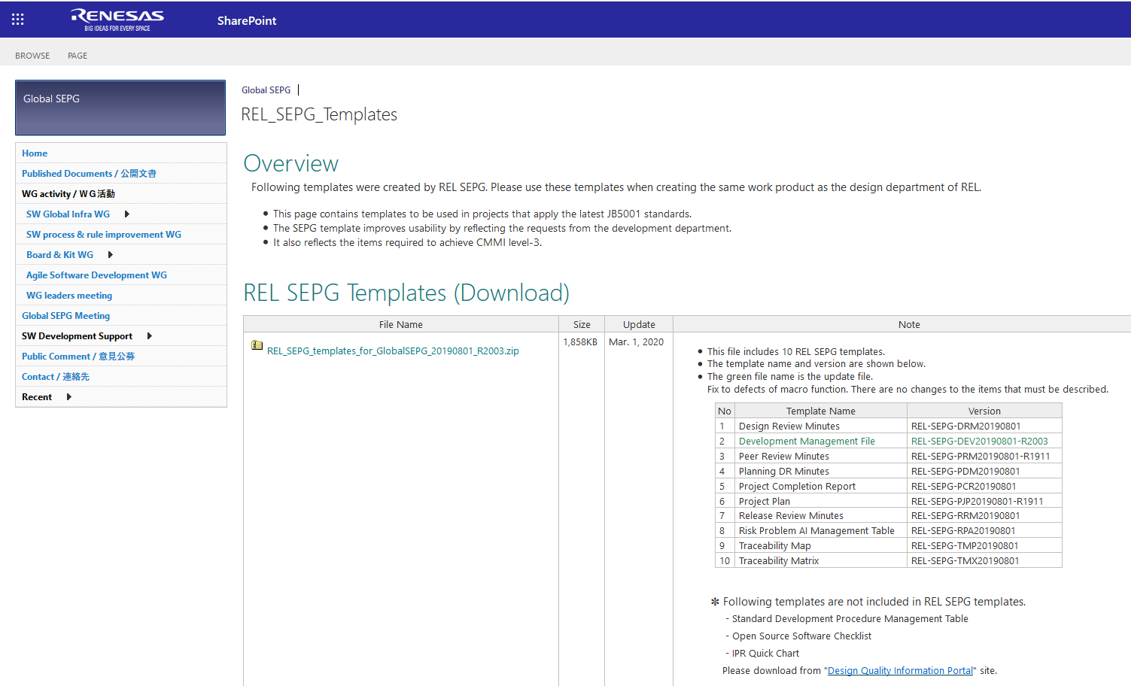
overview Templates
RVC SPO
REL QAD SPO
Global SEPG SPO
Global SEPG templates

Slide 28
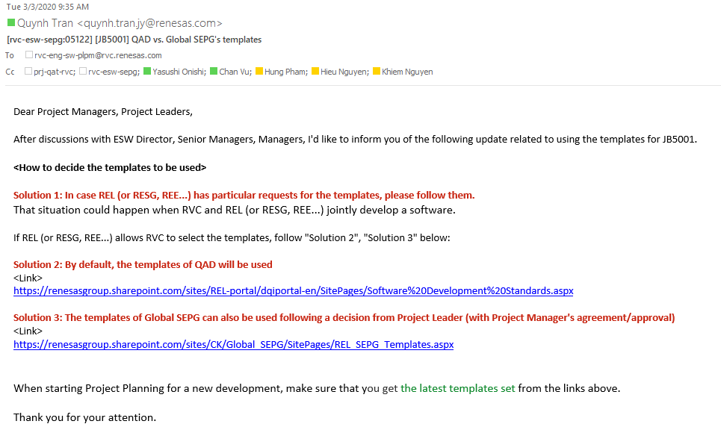
overview Templates
Question: There are QAD template and Global SEPG template, which one should project use?
Answer:

Slide 29
overview template – highlight
CM differences between REL QAD templates and Global SEPG templates:
-> Question:
How do project plan CM objects and CM type? (vJul 2019)
How do project define Baseline Management plan? (vAug 2020)
Template | CM table | Baseline Management plan
JB5001 v.Apr 2017 | Exist | -
JB5001 v.May 2018 | Not exist but Standard requires | -
JB5001 v.Jul 2019 | Not exist but Standard requires | -
JB5001 v.Aug 2020 | Removed in Standard | Not exist but Standard requires
Global SEPG | Exist | -
Notes:
How about Jira, Agile stlye?

Slide 30
overview template – highlight
JB5001 - 16.5. Creation of the Master Schedule
“The project leader defines the work to be performed in the project and creates a master schedule for the achievement of project objectives. The master schedule is required to involve the period of development work, DR plan, baseline plan (The base point of reproduction of delivered products etc.), development schedules for related projects and semiconductor products, and release plan (for example α, β, MP releases). Regarding the baseline, see "Software Development: Implementation Standard for Configuration Management and Change Management" (RCT-JB5001-011).”
JB5001-011 - 6.3.3. Implementation of Baseline Management
“The baseline management plan includes information on the baseline establishment date, storage location, and baseline management objects.”
Notes:
How about Jira, Agile stlye?

Slide 31
overview template – highlight
1. How do project plan CM objects and CM type? (vJul 2019)
Suggestion: To use SDPMT if CM table is not available.
Adding a column to classify which work product apply Data Management, Version Management, Baseline Management is highly recommended.
2. How do project define Baseline Management plan? (vAug 2020)
Suggestion:
Even though CM table, Config audit are removed in Aug 2020 standard, main CM activities still remains almost as same as Jul 2019.
SDPMT, Jira or Redmine all are acceptable as long as latest JB5001-011 are covered.
Notes:
How about Jira, Agile stlye?

Slide 32
CM

Slide 33
Standard summary

Slide 34
standard summary jb5001-011 purpose
Configuration Management
Correctly update Project’s work product to enable right versions of the work product to be retrieved
Maintain the integrity of all work products according to the requirement
Identify the impact on work products when requests or requirements are changed
No lacking, no redundant, no conflict among requests, requirements and design contents
Traceability Management
Manage all the impacts correctly implemented between Requirement changes and Design contents
Manage all change, addition, and deletion of functional and non-functional requirements
Change Management

Slide 35
standard summary ww standard definition
Data management:
- to store specific work products created in software development in a specific place.
Version management:
to store number, change history, etc.,
to store the work prescribed work products created by software development in a specific place,
to record the version products of each version so that they can be identified and retrieved.
Baseline management:
an extension of version management,
to store the work product group at a certain point in software development and the work product group necessary for reconstruction of software separately so that they can be retrieved.
Notes:
Prescribed = quy định
In vs By: will PP be “work product created by software development”? Lot of argument on this point but what WW standard defines? -> Next page

Slide 36
standard summary ww standard definition
Config. audit:
objectively confirm that configuration management are conducted in accordance with the configuration management plan,
objectively confirm data management objects, version management objects and baseline management objects are registered correctly.
(Not applicable in Aug 2020 WW standard)

Slide 37
standard summary ww standard definition
Configuration Management
Data Management
Config. Audit
Customers input, minutes, progress reports, review minutes, tools, development environment, etc.
Version Management
Project Plan, Functional Design Document, Detail Design Document, Source Code, Test Specifications, Test Report, etc.
Baseline Management
(no specific work product required in Standard)
Notes:
In vs By: will PP be “work product created by software development”?
PP = important work product?

Slide 38
standard summary ww standard definition
Time: Each completion of work, process or milestone
Data Management
Config. Audit
Customers input, minutes, progress reports, review minutes, tools, development environment, etc.
Time: Each completion of work, process or milestone
Version numbers and changes can be identified
Version Management
Project Plan, Functional Design Document, Detail Design Document, Source Code, Test Specifications, Test Report, etc.
Time: “Each break” point
Saved date, baseline name, different information from last baseline, etc.
Baseline Management
(no specific work product required in Standard)

Slide 39
standard summary ww standard definition
Time: Each completion of work, process or milestone
Data Management
Config. Audit
Customers input, minutes, progress reports, review minutes, tools, development environment, etc.
Time: Each completion of work, process or milestone
Version numbers and changes can be identified
Version Management
Project Plan, Functional Design Document, Detail Design Document, Source Code, Test Specifications, Test Report, etc.
Time: “Each break” point
Saved date, baseline name, different information from last baseline, etc.
Baseline Management
(no specific work product required in Standard)

Slide 40
standard summary ww standard definition
Data Management, Version management: Each completion of work, process or milestone
-> No clear definition in WW about what is work completion.
Example:
In Testing process:
Test spec created = Completion of work?
Test spec finished PR (PR of Test spec approved) = Completion of work?
-> Recommendation:
In PP, Project team should define ahead “Completion of work”. It can be one of the below conditions:
After author created work product for a requirement/a task, after PR finding fixed, after approval provided.
After Task completion.
Weekly, monthly committing.

Slide 41
standard summary ww standard definition
Baseline management: “Each break” point? ->
initial baseline, before design phase:
new development: 1st version of work products in PP phase,
re-use development: 1st version of work products in PP phase + a set of products to be reused,
before any DR of any process or milestone,
before release review,
after DR, release review finding fixed.

Slide 42
standard summary ww standard definition
Baseline management: “Each break” point? ->
initial baseline, before design phase:
RVC old rule: PP DR within 3 weeks from Project start day
before any DR of any process or milestone:
JB5001/ section 15: DR interval is up to 3 months
before release review.
after DR, release review finding fixed.
JB5001-011, section 6.3.1
Baseline timing (mandatory)
Baseline timing (as necessary)
Notes:
QAM knows the start day of project in FUP weekly meeting

Slide 43
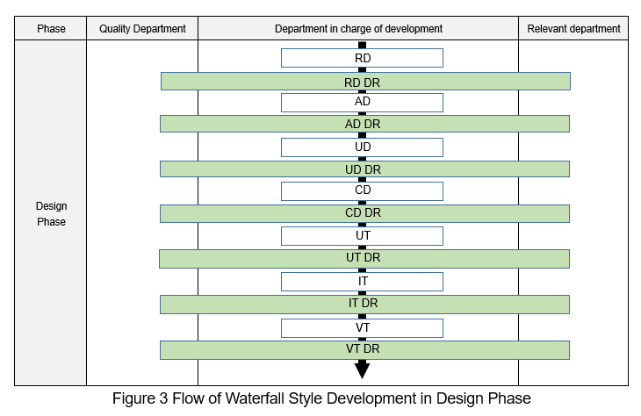
standard summary ww standard definition
Baseline timing (mandatory)
Baseline timing (as necessary)
Notes:
No PP phase

Slide 44
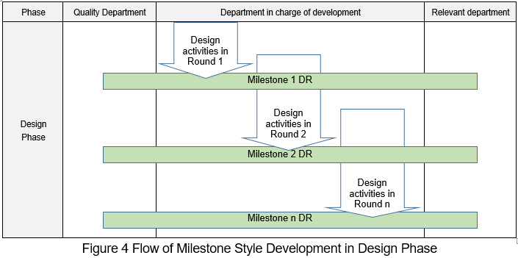
standard summary ww standard definition
Baseline timing (mandatory)
Baseline timing (as necessary)
Notes:
No PP phase

Slide 45
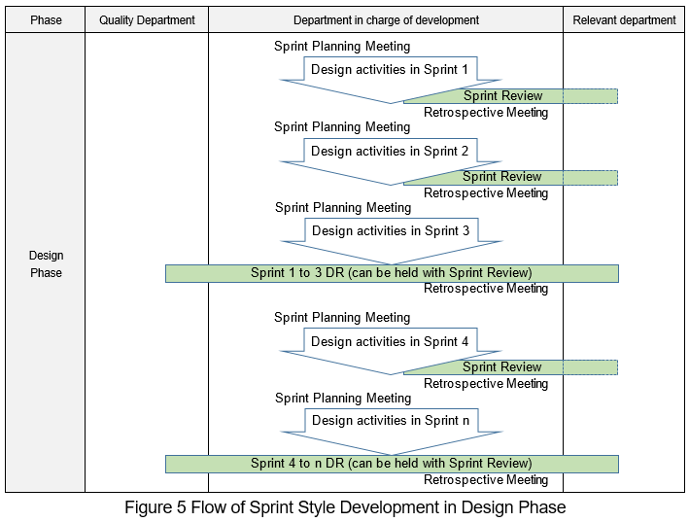
standard summary ww standard definition
Baseline timing (mandatory)
Baseline timing (as necessary)
Notes:
No PP phase

Slide 46
standard summary ww standard definition
PP configuration audit timing:
Project plan is allowed to be approved after PP DR (Planning DR) as JB5001 – section 8.1.
-> In consequence, Config. Audit is agreed by RVC, REL QAs that Project can do PP Config. Audit after PP DR.
(Not applicable in Aug 2020 WW standard)

Slide 47
standard summary bm – vm - dm
Store an object to a defined place
Data Management
Version Management
Baseline Management

Slide 48
standard summary bm – vm - dm
Store an object to a defined place
Data Management
The storage version should link to the related requirement/ task/ finding
Version Management
The storage timing should be frequently happened
Baseline Management

Slide 49
standard summary bm – vm - dm
Store a set of objects to the defined place
Data Management
The storage version should link to the related requirements/ process/ milestone/ sprints/ finding
Version Management
The storage duration should not >3 months
Baseline Management
Baseline ID have to be agreed by related stakeholders
Baseline ID should be sent to Config. Auditor

Slide 50
JB5001 jul 2019

Slide 51
standard summary cm procedure & Role
PL
Define Plan: define operation rule, Config. audit plan, assign PIC
Manager/ Senior Manager/ Director (*)
Approve/ Authorize Plan
Re-approve/ Re-authorize plan if any change
Re-plan for Baseline establishment date, Config. audit date if any change of schedule meets Criteria of the deviation in PP
Define CM structure
Approve Config. Audit table
Output
JB5001, section 16.2.1
JB5001-011, section 6
Project plan/ section Configuration management; Baseline establishment and configuration audit
SDPMT, Development Management/ CM table,
CM structure (complex output)
Baseline establishment and Project plan/ section configuration audit
Approved Development Management/ Configuration audit table
Approved Project plan, SDPMT
(*) Refer Local rule of Project plan approval

Slide 52
standard summary cm procedure & Role
CM PIC
Team members
Monitor and control DM, VM, BM
Data management: Store files at completion of work, process or milestone
Version management: Store files at completion of work or process with version numbers and changes recorded
Baseline Management:
Baseline management: Stores the baseline managed objects with baseline information recorded
Decide a corrective measure for Config. audit finding and due date
Plan the objects for each baseline
Establish the initial baseline in the planning phase
Establish the baseline for each break point: before DR of any process or milestone & before release review
Implement the corrective measure for Config. audit finding, and record the date of corrective implementation
Re-establish after DR, release review finding fixed
Output
SDPMT, Development Management/ CM table,
CM structure (complex output)
Baseline ID sent to related stakeholders
(JB5001-011, section 6)
Deve. Mana/ Config. Audit table
Work product committed at Defined location
Work product committed at Defined location with reason of change recorded
Baseline ID with baseline name, different information from last baseline, etc. sent to related stakeholders
Deve. Mana/ Config. Audit table

Slide 53
standard summary cm procedure & Role
Config. Auditor
Start Config. audit after receiving the Baseline ID from PL/ CM PIC
Open Config. Audit plan to check the scope audit (which process/ milestone/ sprint)
Record the result in Config. audit table and notify project members
Confirm DM objects, VM objects and BM objects are registered correctly
Get approval from PL
Confirms the result of the corrective measure and records the date of corrective confirmation
Output
JB5001-011, section 6.4
Fulfilled Deve. Mana./ sheet Config. Audit table with checked Baseline ID
Verified Deve. Mana./ sheet Config. Audit table with checked Baseline ID
Approved Deve. Mana./ sheet Config. Audit table

Slide 54
standard summary cm procedure & Role
Config. Auditor
Start Config. audit after receiving the Baseline ID from PL/ CM PIC
Open Config. Audit plan to check the scope audit (which process/ milestone/ sprint)
Record the result in Config. audit table and notify project members
Confirm DM objects, VM objects and BM objects are registered correctly
Get approval from PL
Confirms the result of the corrective measure and records the date of corrective confirmation
Output
JB5001-011, section 6.4
Fulfilled Deve. Mana./ sheet Config. Audit table with checked Baseline ID
Verified Deve. Mana./ sheet Config. Audit table with checked Baseline ID
Approved Deve. Mana./ sheet Config. Audit table

Slide 55
JB5001 aug 2020

Slide 56
standard summary cm procedure & Role
PL
Define Plan:
Manager/ Senior Manager/ Director (*)
Approve/ Authorize Plan
Re-approve/ Re-authorize plan if any change
Assign CM PIC
Data, Version and Baseline management method (tools or forms)
Branch and merge management policy (timing, means, reasons, etc.)
Change management method (tools or forms)
Traceability management method (tools or forms)
Backup procedure (timing, recovery method, etc.)
Security measures (virus check, access management etc.)
Re-plan for Baseline management plan if any change of schedule meets Criteria of the deviation in PP
Output
Project plan/ section Development Strategy, SDPMT,
Baseline management plan
JB5001, section 16.2.1
& section 16.5 & section 16.8.
JB5001-011, section 6.
Appendix 2 Work Product Definition.
SDPMT,
Baseline management plan
Approved Project plan, SDPMT
(*) Refer Local rule of Project plan approval

Slide 57
standard summary cm procedure & Role
CM PIC
Team members
Monitor and control DM, VM, BM
Data management: Store files at completion of work, process or milestone
Version management: Store files at completion of work or process with version numbers and changes recorded
Baseline Management:
Baseline management: Stores the baseline managed objects with baseline information recorded
Plan the baseline management objects for each baseline in the planning phase
Establish the initial baseline in the planning phase
Establish the baseline for each break point: before DR of any process or milestone & before release review
Re-establish after DR, release review finding fixed
Output
Progress meeting minutes (optional)
SDPMT, Baseline management plan
Baseline ID sent to related stakeholders
(JB5001-011, section 6)
Work product committed at Defined location
Work product committed at Defined location with reason of change recorded
Baseline ID with baseline name, different information from last baseline, etc. sent to related stakeholders

Slide 58
Practical cases

Slide 59
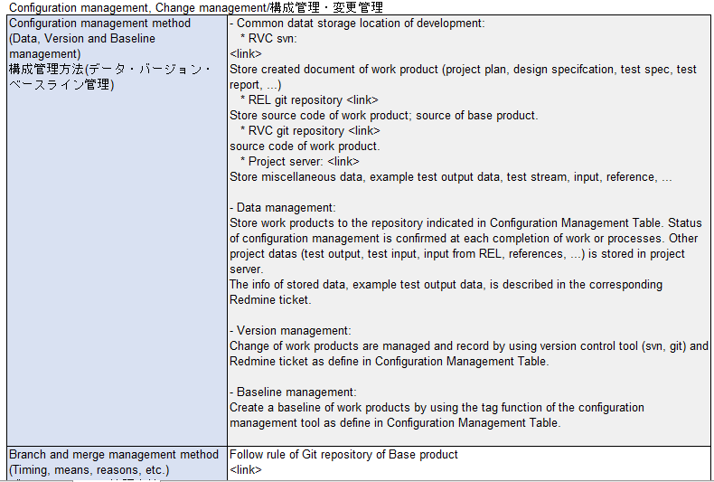
Practical cases waterfall real project

Slide 60
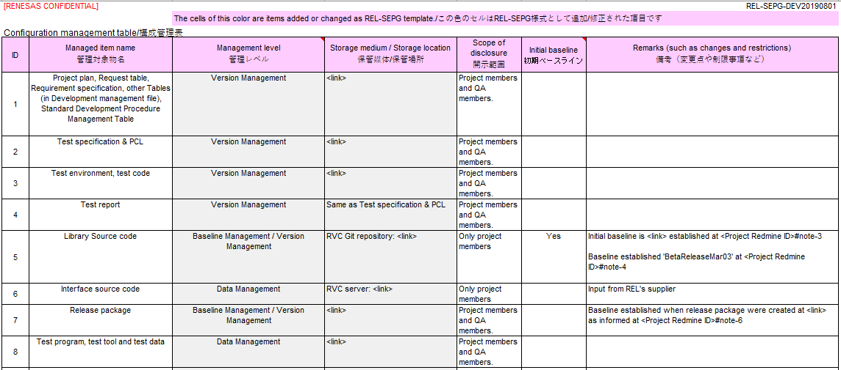
Practical cases waterfall real project

Slide 61
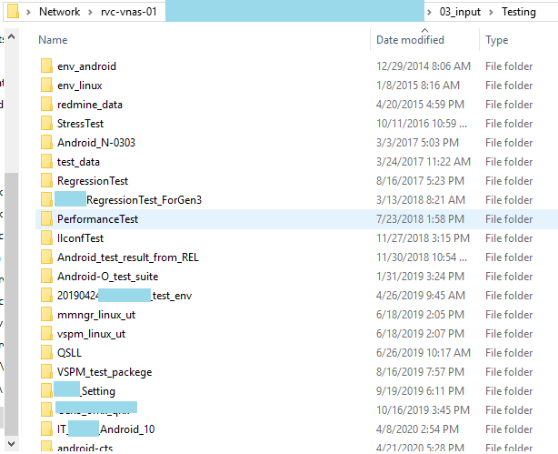
Practical cases waterfall real project
Data Management objects

Slide 62
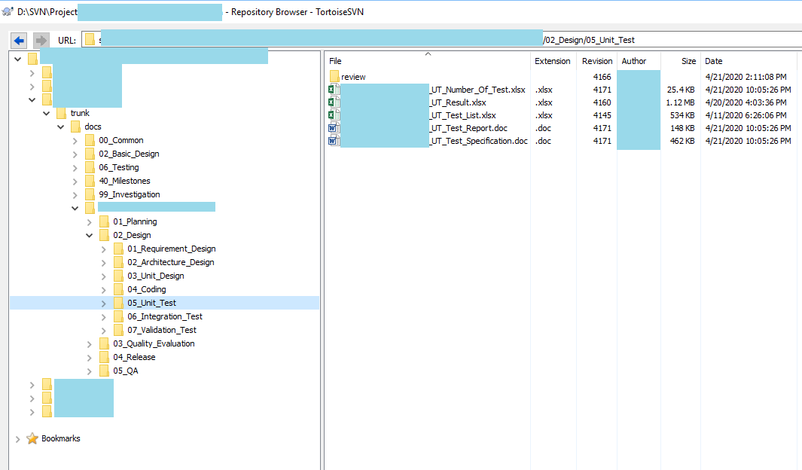
Practical cases waterfall real project
Version Management objects

Slide 63
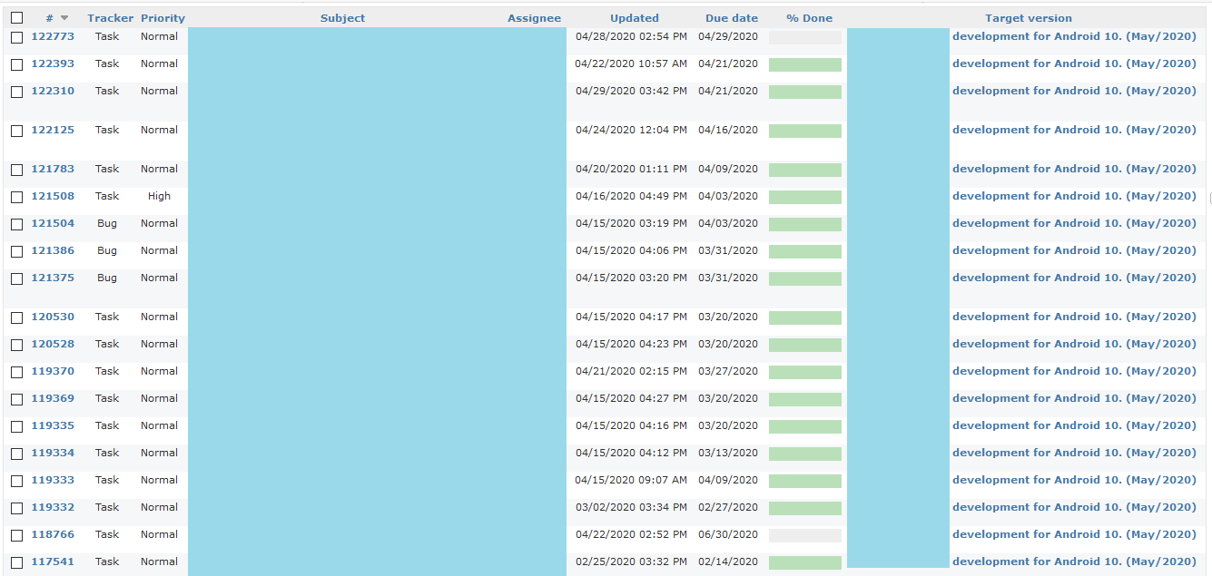
Practical cases waterfall real project
Version Management objects

Slide 64
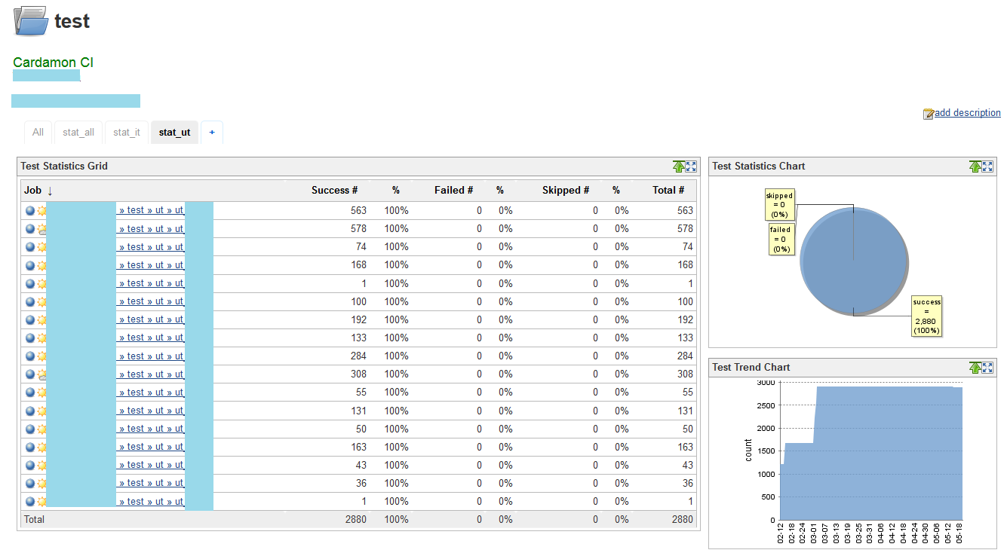
Practical cases waterfall real project
Version Management objects

Slide 65
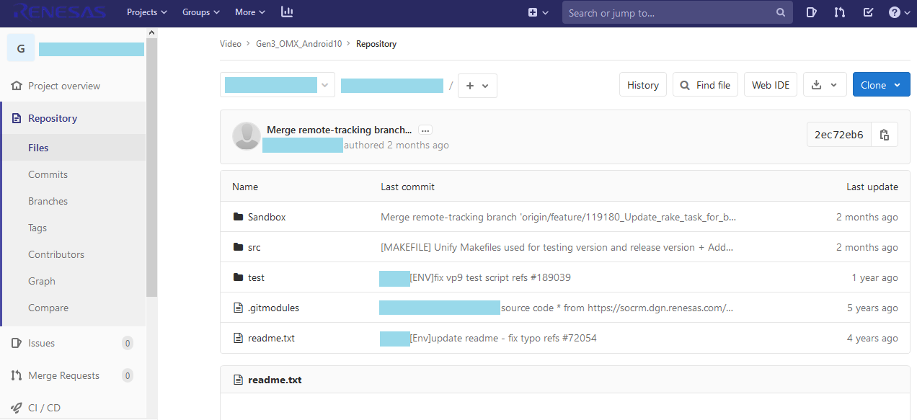
Practical cases waterfall real project
Baseline Management objects

Slide 66
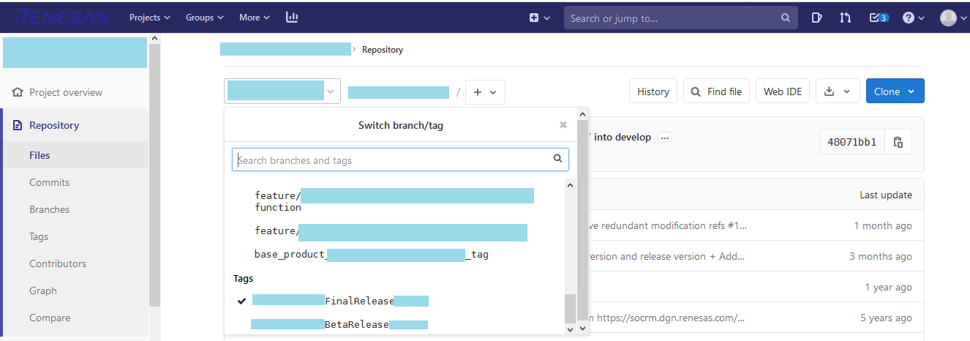
Practical cases waterfall real project
Baseline Management objects

Slide 67
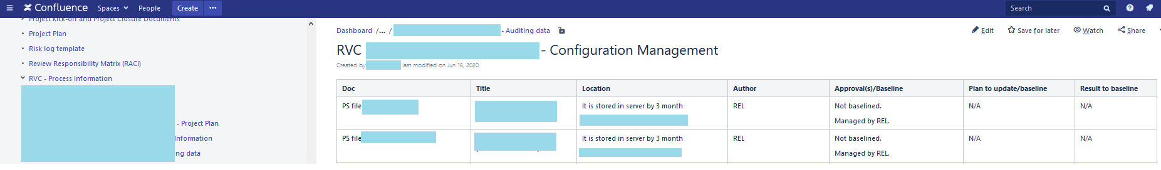
Practical cases agile real project
CM table/ CM object list

Slide 68
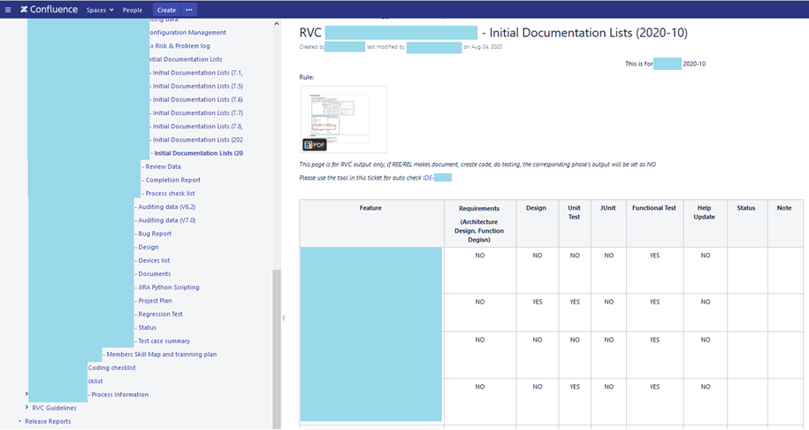
Practical cases agile real project
Baseline management plan and implementation

Slide 69
Cm finding from QA auditing rvc
# | 19K | 19S | 20K | 20S (Before Aug 2020 WW)
CM finding | 34 | 39 | 15 | 18
Total finding | 337 | 251 | 80 | 65
% CM finding | 10 | 16 | 19 | 28

Slide 70
Cm finding from QA auditing rvc 2019
Finding type | Jan | Feb | Mar | Apr | May | Jun | Jul | Aug | Sep | Oct | Nov | Total
FC | 2 |  | 1 | 4 | 5 | 5 | 1 | 4 | 2 | 7 | 5 | 36
NC | 8 | 3 | 2 | 2 | 4 | 3 | 4 | 4 | 2 | 4 | 1 | 37
Grand Total | 10 | 3 | 3 | 6 | 9 | 8 | 5 | 8 | 4 | 11 | 6 | 73
CM finding | Jan | Feb | Mar | Apr | May | Jun | Jul | Aug | Sep | Oct | Nov | Grand Total
Baseline creating | 3 |  | 1 | 1 |  |  | 1 | 1 | 1 | 1 | 1 | 10
CM plan | 1 | 2 |  |  | 2 | 1 | 2 | 1 |  | 1 |  | 10
CM table | 4 |  | 1 | 2 | 3 | 2 | 1 | 3 | 1 | 4 | 2 | 23
Config audit | 2 | 1 | 1 | 3 | 4 | 5 | 1 | 3 | 2 | 5 | 3 | 30
Grand Total | 5 | 3 | 3 | 6 | 9 | 8 | 5 | 8 | 4 | 11 | 6 | 73

Slide 71
Cm finding from QA auditing rvc 2020
CM finding | Jan | Feb | Mar | Apr | May | Jun | Jul | Aug | Grand Total | %
FC (related to CM) | 0 | 1 | 1 | 3 | 3 | 4 | 15 | 0 | 27 | 35%
Total FC | 4 | 3 | 3 | 14 | 3 | 6 | 45 | 0 | 78
NC (related to CM) | 0 | 0 | 0 | 1 | 2 | 0 | 3 | 0 | 6 | 9%
Total NC | 1 | 3 | 7 | 6 | 25 | 5 | 16 | 4 | 67

Slide 72
Practical cases config. Audit suggestion
To reduce QA finding in Config. Audit, PL should define Project confirmation method from PP time following Project rule in PP.
Config. Auditor can quickly catch up the audit method.
Example:
(Not applicable in Aug 2020 WW standard)

Slide 73
Practical cases folder structure case 1 – small scope project
SVN structure: 3 main folders
Version Management:
Follow JB5001-011/ section 6 is mandatory
Use SDPMT/ the blue cells to check back if any lacking document
Data Management:
SDPMT is not clearly defined all DM object, project should self check project reality
Follow JB5001-011/ section 6 is mandatory
Baseline Management: to store a set of work product at “each break”

Slide 74
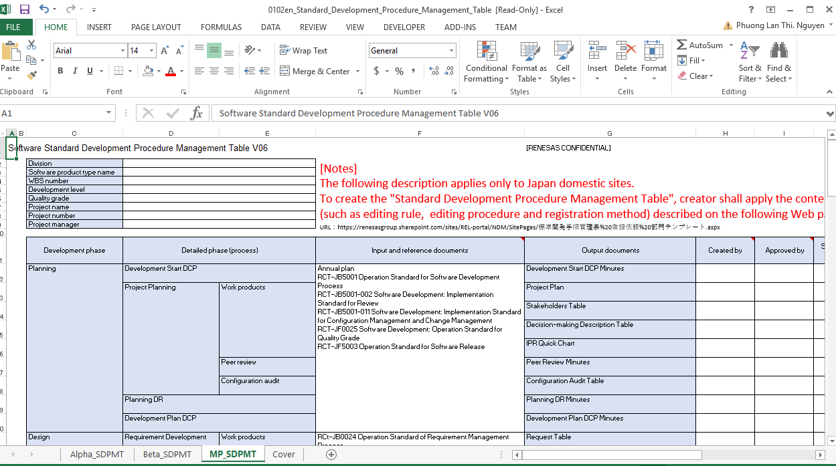
Practical cases folder structure case 2 – multi scope, high headcount project
Work products in each release should be planned in each SDPMT sheets.
Check JB5001-011/ section 6 to avoid any lacking document
Example:
Alpha release, implements in 3 months.
Total Requirement: n amount.
Impacted processes: PP, RD, UD, CD, UT, IT, VT
Beta release, implements in next 3 months.
Total Requirement: m amount.
Impacted processes: RD, IT, VT
2 sets of work products should be planned separately.

Slide 75
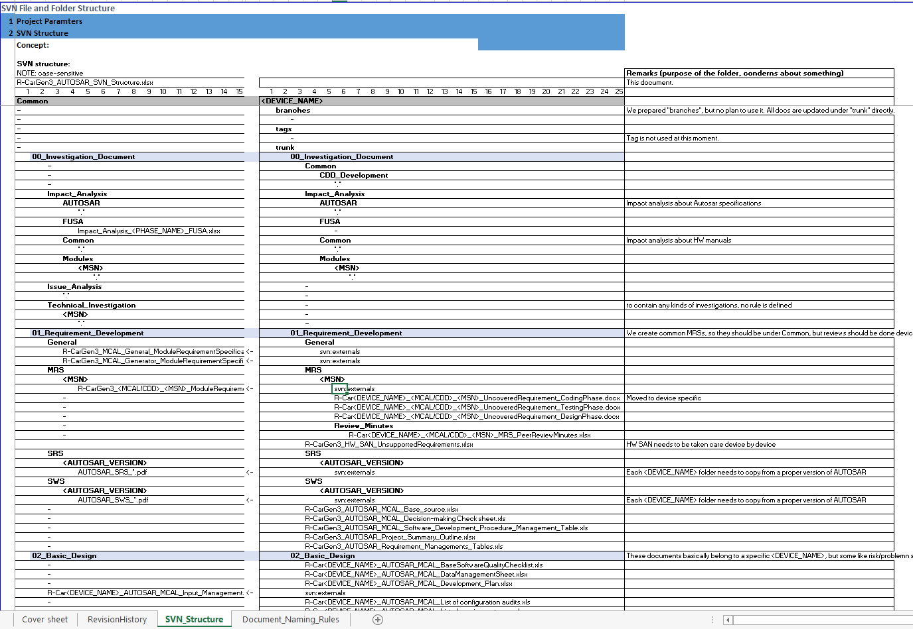
Practical cases folder structure case 2 – multi scope, high headcount project
3. CM plan with an up-to-date and detail SVN structure for 1 sample module should be created.

Slide 76
CRM

Slide 77
standard summary CRM Purpose
Configuration Management
Correctly update Project’s work product to enable right versions of the work product to be retrieved
Maintain the integrity of all work products according to the requirement
Identify the impact on work products when requests or requirements are changed
No lacking, no redundant, no conflict among requests, requirements and design contents
Traceability Management
Manage all the impacts correctly implemented between Requirement changes and Design contents
Manage all change, addition, and deletion of functional and non-functional requirements
Change Management
Additional rule:
JB5001, section 10. Change and Cancellation of the project plan:
“2) There has been a large change in the requests from the customer or market, and it is expected that an additional investment in the development will be required because of a design change outside the scope of the project plan.”
-> The re-Planning DR and the Extraordinary Development DCP are required.

Slide 78
standard summary CRM procedure
Change Management
What is CR?
“If changes are made in requirements after the completion of the Requirement Development Process, the changes are managed in compliance with “Software Development: Implementation Standard for Configuration Management and Change Management” (RCT-JB5001-011).”
“Request for addition, change or deletion has required after the Architecture Design Process on the requirements (functional requirements, non-functional requirements) formulated in the requirement development process.”
“Change of the work product to the purpose of defect correction is managed in accordance with 7. Procedure for Defect Management, RCT-JB5001-007).”
(JB5001-003, section 8)
(JB5001-011, section 7.1)

Slide 79
standard summary CRM procedure & Role
Change Management
Reception of CR
Project members, CRM, PL, PM,…
Recording of CR
CRM PIC
Analysis of the Impact of CR
CRM PIC, Project members
Evaluation and Planning of CR
CRM PIC, PL, PM
Change Implementation
Project members, PL
Monitoring and Control of Changes
CRM PIC, PL

Slide 80
standard summary CRM procedure & Role
Change Management
PL
Define Plan: define operation rule, assign CRM PIC
Monitor and control any CRM’s risk/ problem
Manager/ Senior Manager/ Director (*)
Approve Project Plan if schedule changed
Evaluate and plan for CR (if needed)
Approve the result of implemented CR
Monitor and control any CRM’s risk/ problem
(JB5001, section 8.2.1 and JB5001-011, section 7)
(*) Refer Local rule of Project Plan approval

Slide 81
standard summary CRM procedure & role
Change Management
CRM PIC
Team members
Record CR
Receive CR
Analyze CR on required of CRM PIC
Conduct and record the result of CR impact analysis
Determine, record the result of Evaluation and Planning CR
Implements the change on required
Record result of implemented CR, get PL approval
Monitor and control any CRM’s risk/ problem
(JB5001-011, section 7)

Slide 82
Practical guide
Reception of CR
Project members
Email discussion
Redmine ticket
Jira ticket
Skype discussion
Verbal discussion
…
Recording of CR
CRM PIC
Analysis of the Impact of CR
CRM PIC, Project members
Evaluation and Planning of CR
CRM PIC, PL,PM
Change Implementation
Project members, PL
Monitoring and Control of Changes
CRM PIC, PL

Slide 83
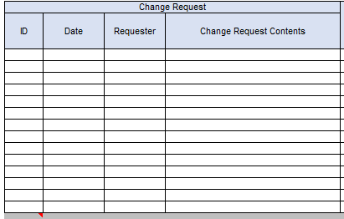
Practical guide
Reception of CR
Project members
Recording of CR
CRM PIC
Analysis of the Impact of CR
CRM PIC, Project members
Evaluation and Planning of CR
CRM PIC, PL, PM
Change Implementation
Project members, PL
Monitoring and Control of Changes
CRM PIC, PL

Slide 84
Practical guide
Reception of CR
Project members
Recording of CR
CRM PIC
Impacted name, design content or version
Impacted stakeholder (customer, design outsourced, and related internal departments)
Estimated man-hours, required duration
Analysis of the Impact of CR
CRM PIC, Project members
Evaluation and Planning of CR
CRM PIC, PL, PM
Change Implementation
Project members, PL
Monitoring and Control of Changes
CRM PIC, PL

Slide 85
Practical guide
Reception of CR
Project members
Recording of CR
CRM PIC
CRM PIC is the main determination maker.
PL, PM involvement might need if any difficult with Impacted stakeholder.
Manager or higher level approval will be needed if the CR impacts to Project schedule, release date, M&A. In this case, re-PP DR might need according to JB5001/ section 10. Change and Cancellation of the project plan/ situation (2).
Analysis of the Impact of CR
CRM PIC, Project members
Evaluation and Planning of CR
CRM PIC, PL, PM
Change Implementation
Project members, PL
Monitoring and Control of Changes
CRM PIC, PL

Slide 86
Practical guide
Test
Code
Design
Reception of CR
Project members
Recording of CR
CRM PIC
Analysis of the Impact of CR
CRM PIC, Project members
List of names and versions of the changed work products
Detailed content of the change
Planned date of sharing the work product with interested person/ impacted stakeholder
Evaluation and Planning of CR
CRM PIC, PL, PM
Change Implementation
Project members, PL
Monitoring and Control of Changes
CRM PIC, PL

Slide 87
Practical guide
Reception of CR
Project members
Email discussion
Redmine ticket
Jira ticket
Skype discussion
Verbal discussion
…
Recording of CR
CRM PIC
Analysis of the Impact of CR
CRM PIC, Project members
Evaluation and Planning of CR
CRM PIC, PL, PM
Change Implementation
Project members, PL
Monitoring and Control of Changes
CRM PIC, PL

Slide 88
Practical Case
This is a practical sharing from RVC project for CR has impacted to Project schedule.

Slide 89
trace

Slide 90
standard summary purpose
Configuration Management
Correctly update Project’s work product to enable right versions of the work product to be retrieved
Maintain the integrity of all work products according to the requirement
Identify the impact on work products when requests or requirements are changed
No lacking, no redundant, no conflict among requests, requirements and design contents
Traceability Management
Manage all the impacts correctly implemented between Requirement changes and Design contents
Manage all change, addition, and deletion of functional and non-functional requirements
Change Management

Slide 91
standard summary trace. Manage. procedure
Trace. Management.
Using traceability system in PR
Project members
Using traceability system for Change Management
Project members
Using traceability system for Defect Management
Project members

Slide 92
Conclusion
Why do you need CM?
Example 1: Sudden leave staff
Example 2: Bug after release to client
Example 3: Daily work within Team

Slide 93
Conclusion
Project level: If bug happens, you can quickly reverse to previous version.
You can detect what was wrong at which steps faster.
Developer newly assigned to project can quickly catch up the project storage way.
Less risk of missing/ refer wrong and out of update baseline.
Manager level: Common storage way in all projects.
Easy to catch up when handover project.
New request arrived, PL/PM can quickly get the correct and latest version of work product to progress next steps.

Slide 94
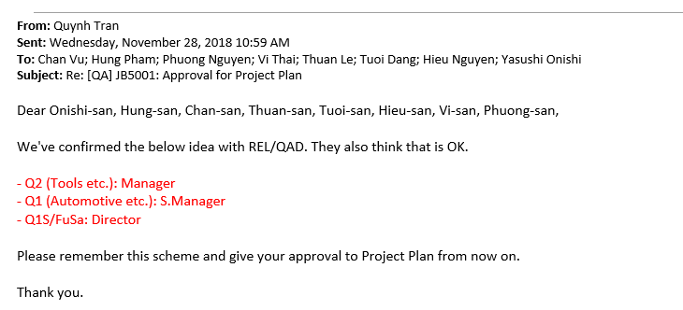
APPENDIX
Back to Jul 2019 WW’s CM procedure
Back to Aug 2020 WW’s CM procedure
Back to CRM procedure

Slide 95
Q&A

Slide 96
Revision history
No | Date | Description | Updated by
0.1 | Apr 05, 2019 | Init the file for standard’s May 2018 version | Phuong Nguyen QA
0.2 | Apr 11, 2019 | Update CM example, different point of Baseline and Version management as QAL review | Phuong Nguyen QA
0.3 | Apr 12, 2019 | Reviewed | Quynh Tran QAL
0.4 | Nov 18, 2019 | Enhance CM for standard’s July 2019 version | Phuong Nguyen QA
0.5 | Dec 30, 2019 | Update “Config audit sample” as comment from Hoang Bui – Experience config. Auditor in OMX project | Phuong Nguyen QA, Hoang Bui SE
0.6 | Dec 30, 2019 | Update “SVN structure sample” as comment from Phong Nguyen PL | Phuong Nguyen QA Phong Nguyen PL
0.7 | Feb 19, 2020 | Update about Baseline Management object, PP config. Audit timing | Phuong Nguyen QA
0.8 | May 03, 2020 | After Team review 1st time: 1. Remove the Illustration of CM objects. Add CM objects’ example from real project. 2. Remove the Illustration of CR | Phuong Nguyen QA
0.9 | Jun 12, 2020 | Update “CM differences between JB5001 v.May 2018 and v.Jul 2019 standards” Update optional and mandatory “baseline timing” | Phuong Nguyen QA
1.0 | Jun 17, 2020 | REL QAD Koji Shimotaka reviewed | Phuong Nguyen QA

Slide 97
Revision history
No | Date | Description | Updated by
1.1 | Aug 12, 2020 | Add information about Standard v.Aug 2020 | Phuong Nguyen QA
1.2 | Sep 10, 2020 | Update as comment from Quynh Tran QAM | Phuong Nguyen QA
2.0 | Oct 09, 2020 | RVC QAM Quynh Tran reviewed | Phuong Nguyen QA

Slide 98
Renesas.com

